Slide 1
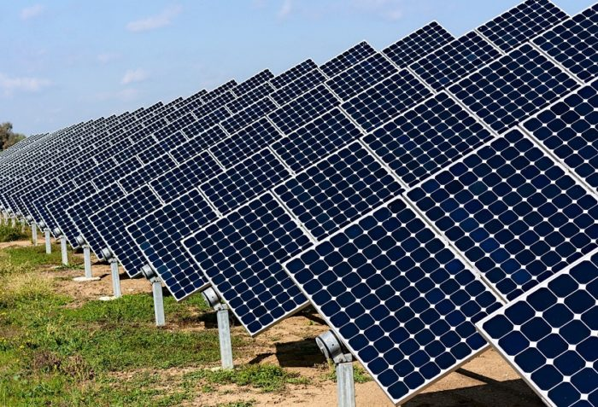
Solar Plant Solar Monitoring and Predictive Maintenance

Slide 2

About the Start-up…
ARTRO ENERGY is a start-up Incubated in College of
Engineering Guindy.
Founded by Alumni of this college, Mr. Ashok Kumar and his colleagues.
This Start-up mainly aims at producing hardware that eases monitoring and maintenance of Solar plants.
The Vision of the company is to produce data logging devices that can log data from all Intelligent devices and make it user-friendly.

Slide 3
Why Solar Energy ?
Comparatively clean source of energy
Reduce dependence on Fossil fuels
Return of Investment
Comparatively less Operation and Maintenance Cost

Slide 4
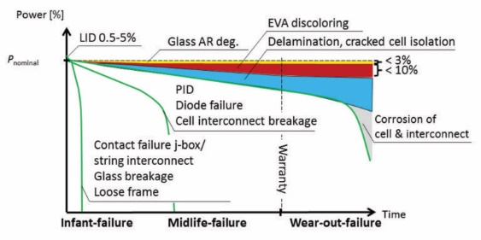
Need for Monitoring Solar Plants

Slide 5
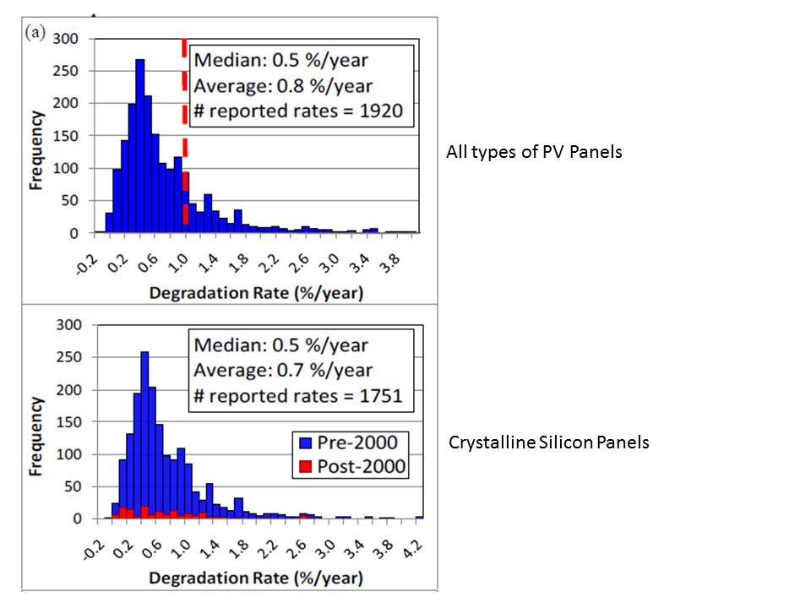
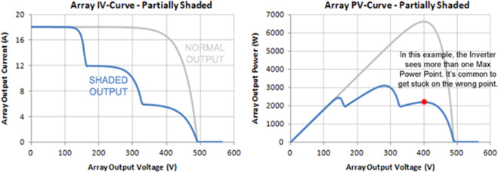
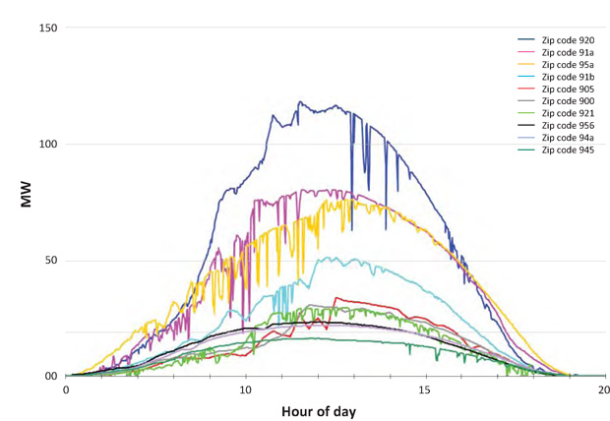
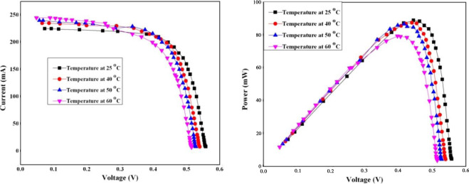
Continued…

Slide 6
What the company does?
Real-Time Information about their Installed Solar plant ANYTIME – ANYWHERE
Internet of Things (IoT)
Easily Understandable by people through Smart Phone
“PREDICTION ” of faults
Increasing Life of Solar Plants

Slide 7
Internet of Things (IoT)
An ecosystem of Connected Physical devices over Internet
Harnessing and Analysing Real-time data
Concept of “Connected” Devices.
Remote access to the connected device

Slide 8
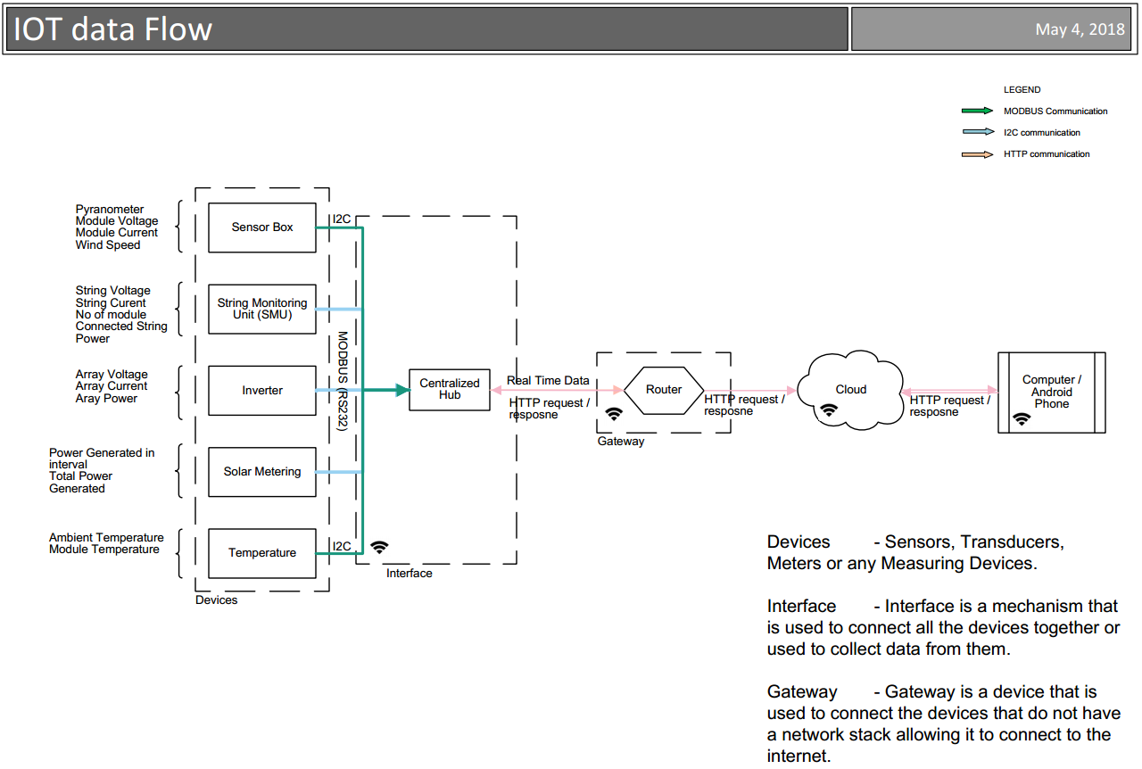
Hardware Development Stages
Flow chart of the Concept… Dataflow stages

Slide 9
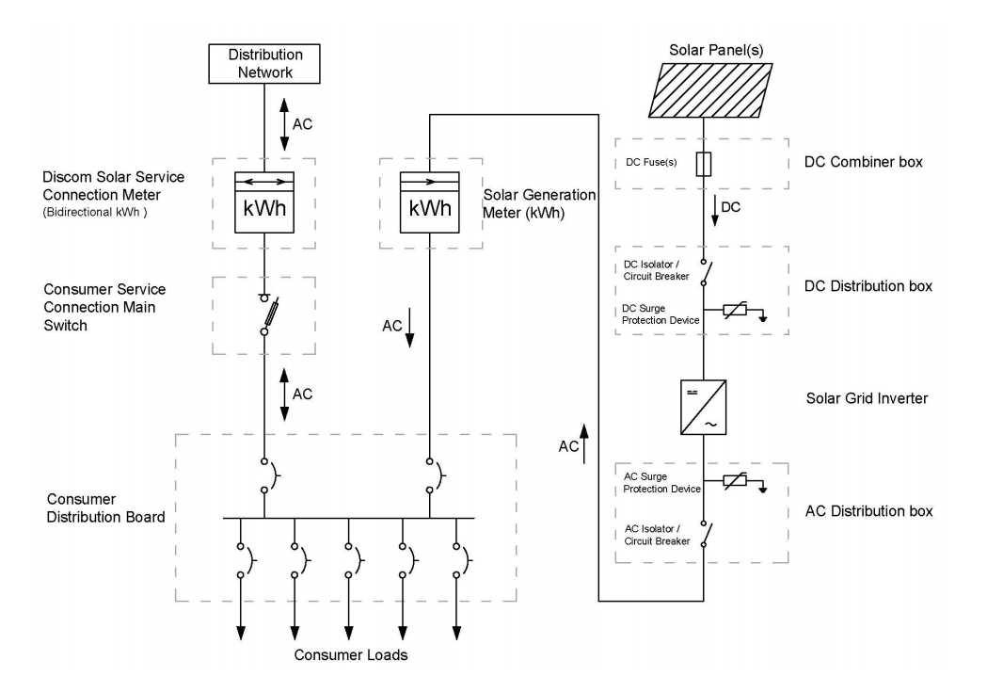
Solar Plant Architecture

Slide 10
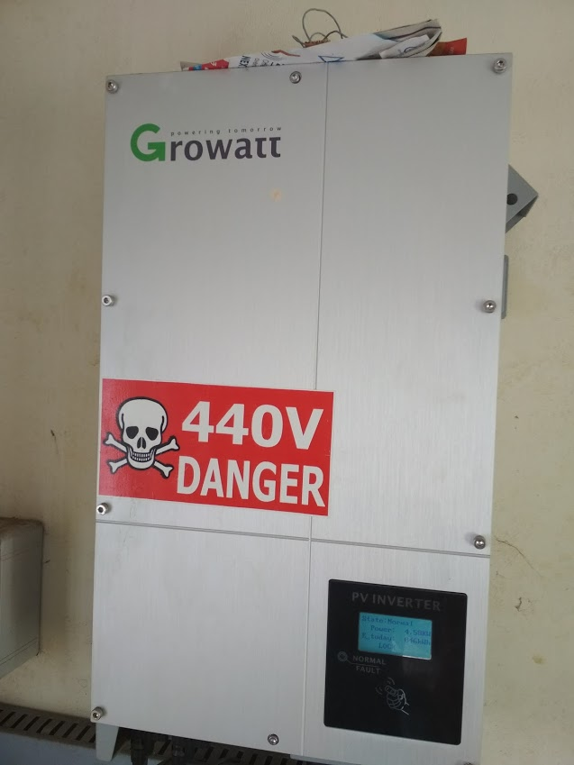
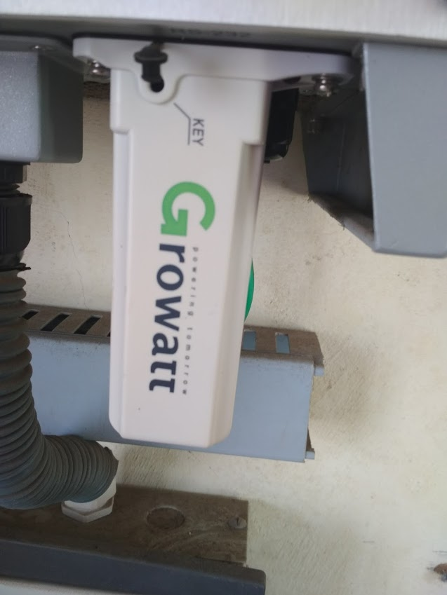
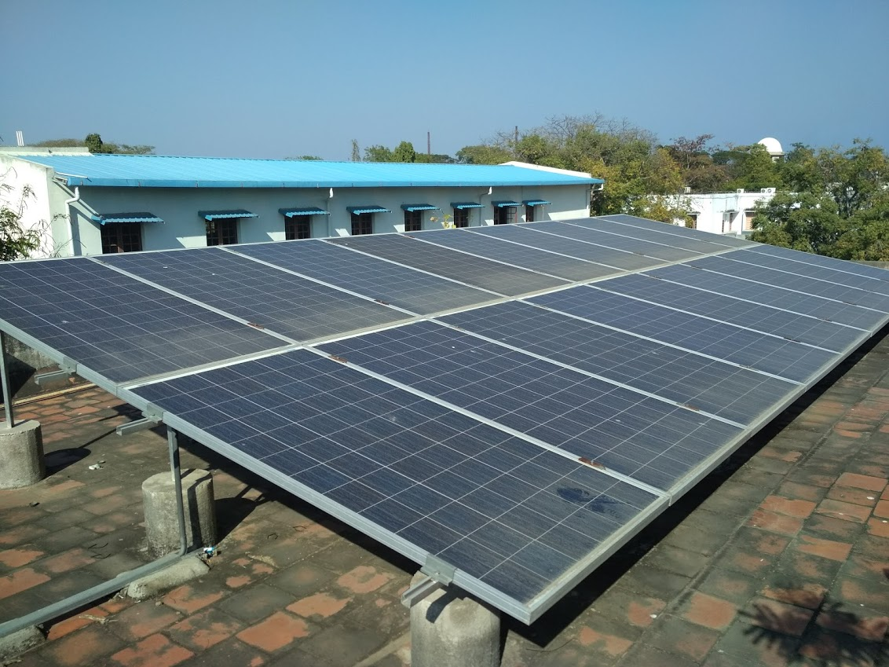
Area of Work: Institute Of Energy Sciences CEG
To develop Hardware prototype for monitoring 10KW Grid-Tied Solar Power Plant
Plant Capacity: 10KW
Inverter: Growatt Solar MPPT Inverter

Slide 11
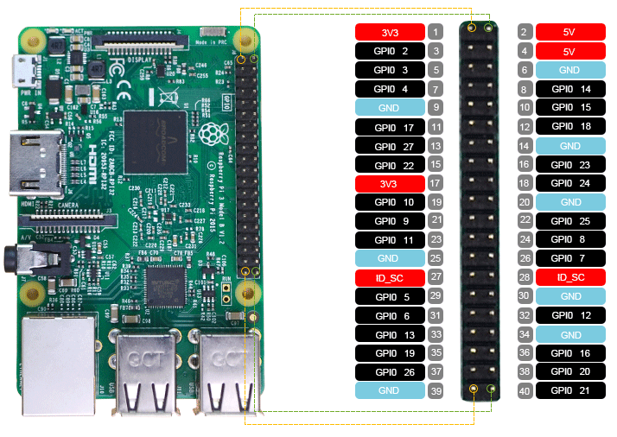
Hardware- Prototype:
Raspberry Pi 3
RS232 to USB
Python Programming
Polling inverter’s memory registers using MODBUS protocol

Slide 12
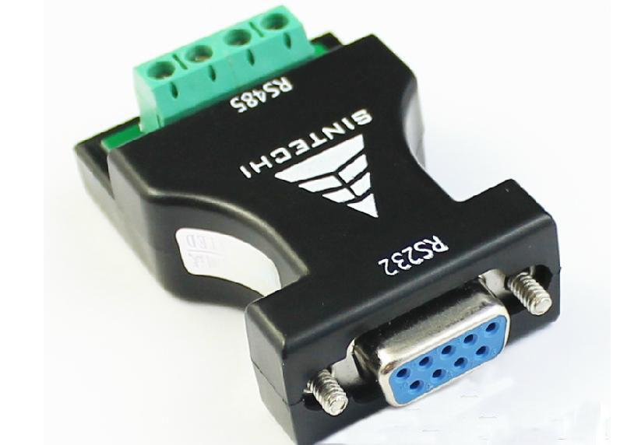
MODBUS Protocol
What is MODBUS?
Master Slave Concept
Types of MODBUS
Ports used
Why MODBUS is used in industrial
grade products?

Slide 13

Working:
Inverter
MODBUS-RS-232
Raspberry Pi
Cloud -Ubidots
User-Interface
Sqlite-Database
Data are stored Locally in Sqlite Database

Slide 14
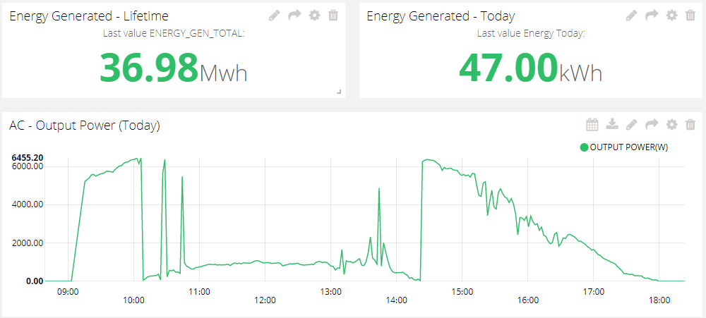
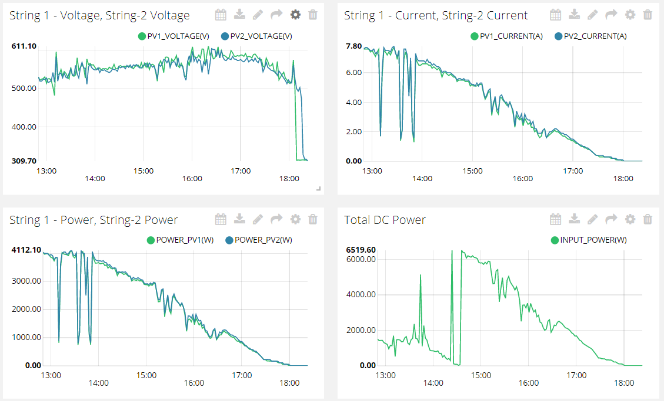
Cloud Services - UBIDOTS
Monitoring Plant health remotely from anywhere
Performance metrics about the plant with login for each user.

Slide 15
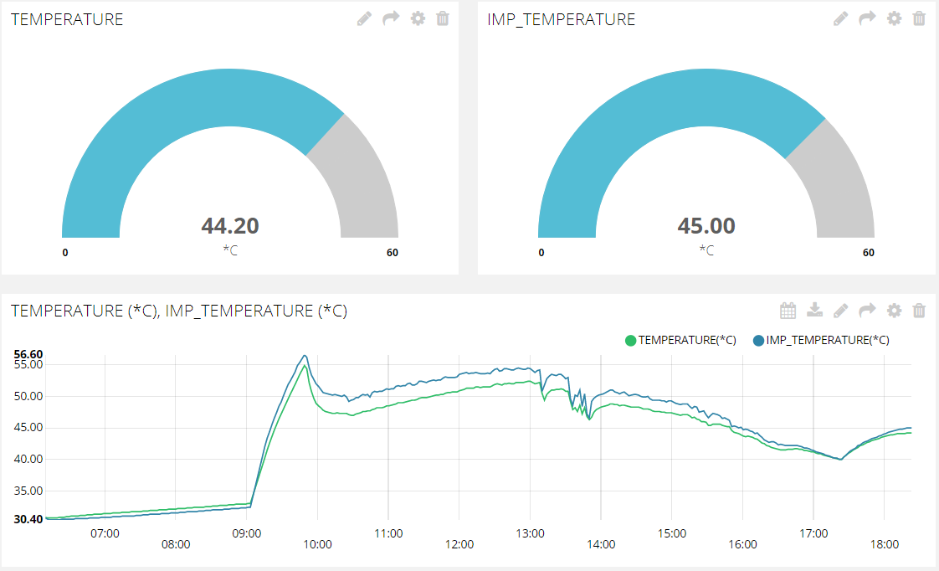
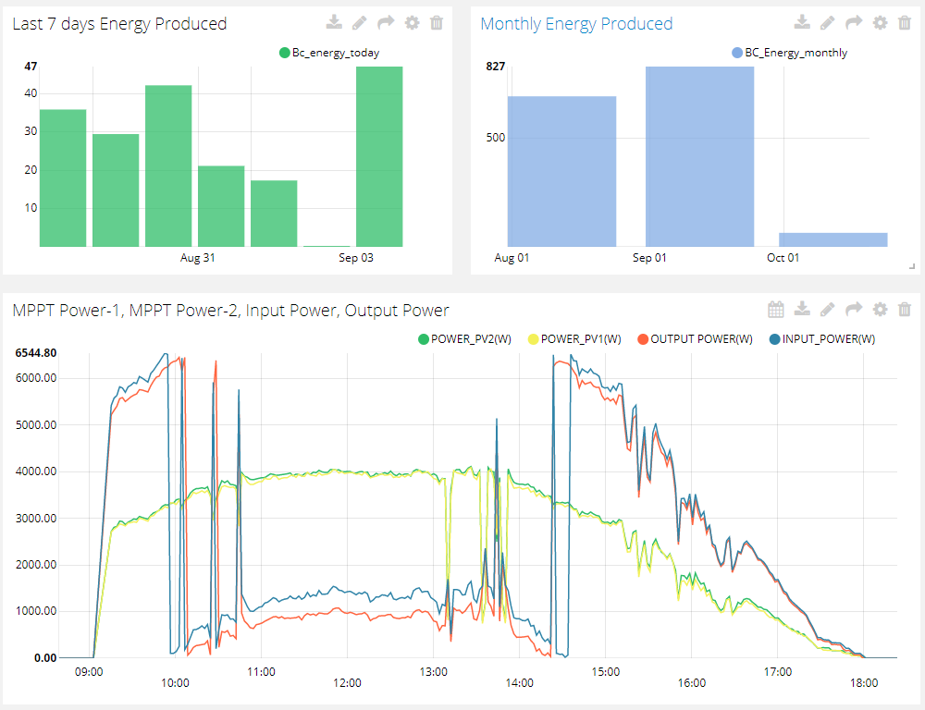
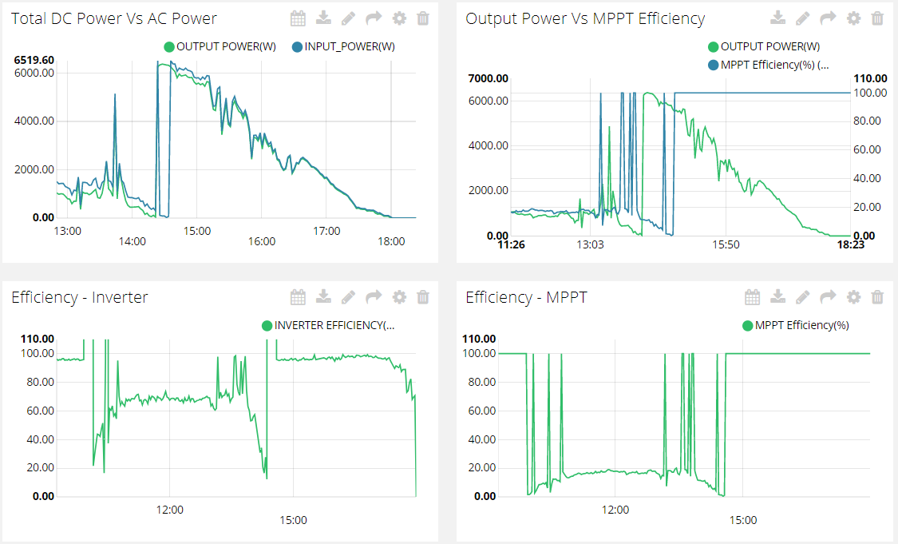

Slide 16
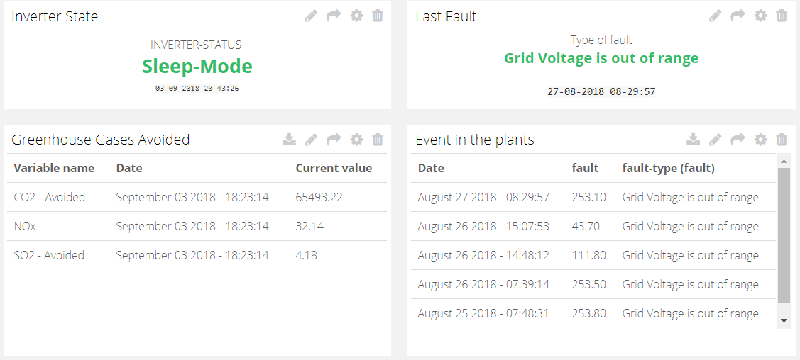

Slide 17
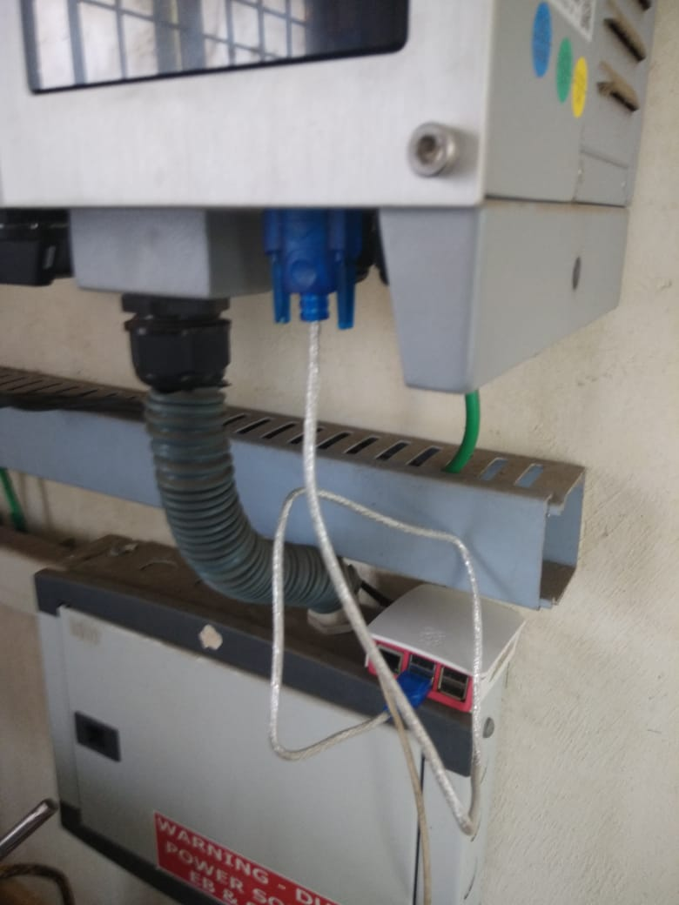
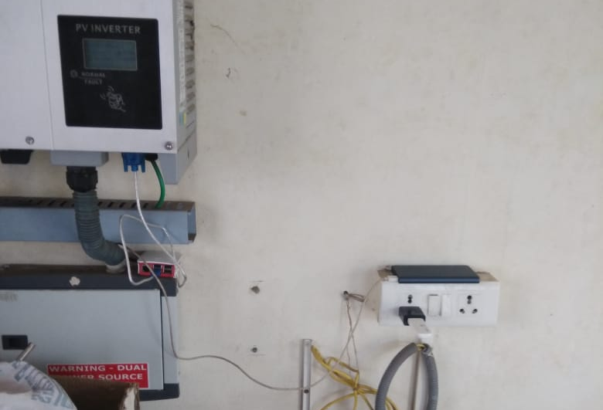
DATA LOGGER AT IES – FUNCTIONAL PROTOTYPE

